Slide 1
Measurement Error Models, Methods, Applications in Nutrition and Environmental Health: Introduction
Donna Spiegelman
Molin Wang
Jingyu Cui
Raymond J. Carroll

Slide 2




Who we Are
Donna
Molin
Raymond
Jingyu

Slide 3
Instructors
Donna Spiegelman
Yale SPH, Over 800 papers (!), Work in field covers nearly 40 years, Epi and Biostat
Molin Wang, Harvard SPH, Epi and Biostat
Jingyu Cui, Yale SPH, Postdoc with Donna
Raymond Carroll, TAMU, Stat and Biostat
Good, brief biosketches via AI, e.g. coPilot

Slide 4
Outline
Basic Introduction (Carroll)
Quick overview of effects of covariate uncertainty (Carroll)
???(Spiegelman)
???
???

Slide 5
Effects of exposure measuremement Error
Nutrition

Slide 6
Broad Overview
Everyone is interested in nutrition
When people ask me what I do, I often say that I study nutrition: true, barely
Then I get asked “what should I eat?” Part of this talk tells you how I answer

Slide 7
Broad Overview
An interesting very negative article is in the NYT by Gary Taubes, Feb 8, 2014
He called for more clinical trials, as if these can actually be done

Slide 8
A “Failed” Clinical Trial
JAMA. 2018;319(7):667-679
What is the effect of a healthy low-fat (HLF) diet vs a healthy low-carbohydrate (HLC) diet on weight change at 12 months and are these effects related to genotype pattern or insulin secretion?

Slide 9
A “Failed” Clinical Trial
Result. There was no significant difference in 12-month weight loss between the HLF and HLC diets, and neither genotype pattern nor baseline insulin secretion was associated with the dietary effects on weight loss.

Slide 10
A “Failed” Clinical Trial
College Station Eagle, Page 6. ☺
“What seemed to make a difference was healthful eating”
“Participants on both diets who consumed the fewest processed foods, sugary drinks, unhealthy fats and ate the most veggies lost the most weight”.

Slide 11
Initial Remarks
I got very interested in nutrition as a science in the 1990’s
I collaborated (them on my grants, me on theirs) with Joanne Lupton, Robb Chapkin and Nancy Turner at TAMU on the following type of simple experiments

Slide 12
Initial Remarks
You feed one group of rats a corn oil enriched diet (the potato chip diet, fun but …)
You feed another group a fish oil enhanced diet
All else equal
Let them munch happily away on their diets for a while

Slide 13
Initial Remarks
So then “we” exposed them to a potent carcinogen (AOM).
We sacrificed them 12 hours later
Wow! Everything lit up showing potato chips are bad (for rats, sigh)
DNA Damage
DNA Repair
Programmed cell death (Apoptosis)
Anything else you can think of

Slide 14
Initial Remarks
Moral I of the story: Diet is a powerful mechanism and a better diet can help protect against cancers, chronic disease, mortalities, etc.
Moral II of the story: I used to eat a bag of popcorn or chips almost daily, and stopped
I look with longing at Kettel chips in the grocery but (mostly) resist

Slide 15
Initial Remarks
Statistics Success: My former student Jeff Morris, now at Penn, wrote his thesis on this problem, and used it to discover Wavelet-based Functional Mixed Models (WFMM)
I had 2 other students who theses were on these topics. Both are chairs of major bio/stat departments
My nutritionists got 6 papers in top statistics journals ☺ They could have gotten tenure ☺
10

Slide 16


Nutrition
Notes:
The adducts are an indicator of carcinogen exposure. The corn oil does not even know? Probably lost this slide.

Slide 17
WHI Dietary Modification Trial
Randomized study 48,835 women aged 50-79
I was not involved
Control group: free living
Randomized group AIMS: lower fat to 20% of calories, saturated fat to 7%, 5 or more servings of fruit and veggies per day, grains to 6 or more servings per day

Slide 18
WHI Dietary Modification Trial
p-value for breast cancer = 0.07. NYT called it a failed study.
Expensive
Lots, and lots of controversy, especially whether it should have been done in the first place (ask Donna Spiegelman)
I was not involved

Slide 19
More Magic Bullet Work:
There are many large cohort studies of diet and health
Not randomized
Large sample sizes (hundreds of thousands)
Includes the Nurse’s Health Study, NIH-AARP Study, UK Biobank, etc.

Slide 20
More Magic Bullet Work: AARP Study
The NIH-AARP Study of Diet and Health had ~300,000 men and ~200,000 women.
They were followed for various cancers, CVD, and various types of mortalities
So, I did an analysis of Saturated Fat, adjusted for Energy intake. Also, adjusted for 20+ covariates.
Compared the 5th quintile to the 1st quintile, which is typical in nutritional epidemiology

Slide 21
Magic Bullet Work: SatFat
 | Hazard Ratio | p-value
Men, Colorectal | 1.01 | 0.91
Lung | 0.99 | 0.88
Women, Colorectal | 0.90 | 0.14
Lung | 1.02 | 0.68
Breast | 1.03 | 0.42
Compare the 1st quintile to the 5th quintile

Slide 22
More Magic Bullet Work: AARP Study
That was pretty dismal, was it not?
I have done this for DOL Veggies (dark green, kale, etc.), and others
Almost nothing shows up, in a one at a time analysis
Inconsistent results (CVD excepted, I think)

Slide 23
Magic Bullet Miracles
Nutritionists know a lot
The literature is massively complex.
They are faced with trying to make public health recommendations that are simple and that people can implement

Slide 24
Super Diets
Restricting calories: hard to do
Eat lots of kale: easier but not particularly pleasurable (family story follows)
Blah Blah: we are bombarded with magic bullet diet tips

Slide 25
Big Picture Miracles: Dietary Patterns
The problem with the magic bullet approach to diet and health is that it does not take into account the complex structure of human diets (my view)
Statistically, diet is largely a type of multivariate compositional data

Slide 26
Big Picture Miracles: Dietary Patterns
Imagine that it is hard to change one’s energy (caloric) intake for long periods of time
I know that this is simplistic, but it a good starting point
20

Slide 27
Big Picture Miracles: Dietary Patterns
In that case, if you decrease your saturated fat intake, something else needs to increase to keep energy intake more or less the same
This is compositional data, of a sort (I do not want to do the technical definition)
Nutritionists have long recognized this (without the buzz word), and I have heard it called a substitution effect

Slide 28
Big Picture Miracles: Dietary Patterns
There are subsequently a fair number of diet indices that account for lots of things in diets, not just one magic bullet at a time
The one I know best is the Healthy Eating Index (HEI, before 2005, 2005, 2010, 2015, 2020, …)
It is based on dietary guidelines put out by the USDA

Slide 29
The Healthy Eating Index - 2005
The HEI-2005 (I have the data) is a composite score that is based on the USDA-2005 Dietary Guidelines
It is a multi-component dietary quality index involving ratios of interrelated dietary components to energy (calories): compositional data
It ranges from 0 to 100, with higher scores better

Slide 30
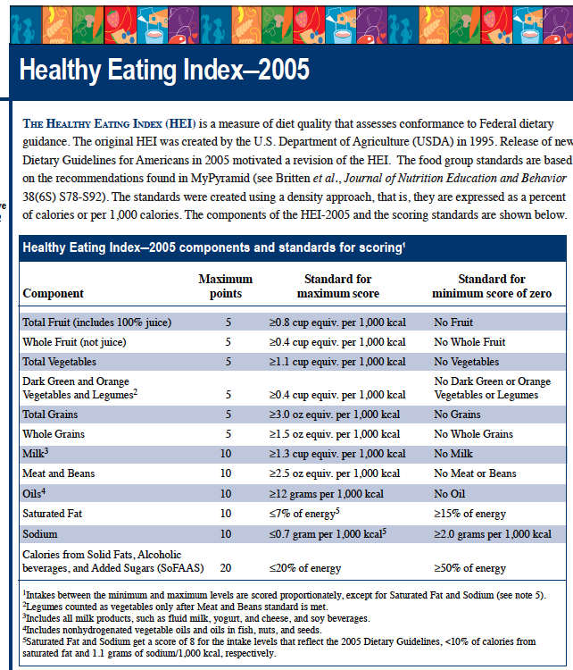
The Healthy Eating Index (HEI) is a measure of diet quality that assesses conformance to Federal dietary guidance. The original HEI was created by the U.S. Department of Agriculture (USDA) in 1995. Release of new Dietary Guidelines for Americans in 2005 motivated a revision of the HEI. The food group standards are based on the recommendations found in My Pyramid (see Britten et al., Journal of Nutrition Education and Behavior 38(6S) S78-S92). The standards were created using a density approach, that is, they are expressed as a percent of calorie or per 1,000 calories. The components of the HEI-2005 and the scoring standards are shown below.
Health Eating Index–2005 component and standards for scoring
Component | Maximum points | Standard for maximum score | Standard for minimum score of zero
Total Fruit (includes 100% juice) | 5 | ≥0.8 cup equiv. per 1,000 kcal | No Fruit
Whole Fruit (not juice) | 5 | ≥0.4 cup equiv. per 1,000 kcal | No Whole Fruit
Total Vegetables | 5 | ≥1.1 cup equiv. per 1,000 kcal | No Vegetables
Dark Green and Orange Vegetables and Legumes | 5 | ≥0.4 cup equiv. per 1,000 kcal | No Dark Green or Orange Vegetables or Legumes
Total Grains | 5 | ≥3.0 oz equiv. per 1,000 kcal | No Grains
Whole Grains | 5 | ≥1.5 oz equiv. per 1,000 kcal | No Whole Grains
Milk | 10 | ≥1.3 cup equiv. per 1,000 kcal | No Milk
Meat and Beans | 10 | ≥2.5 oz equiv. per 1,000 kcal | No Meat or Beans
Oils | 10 | ≥12 grams per 1,000 kcal | No Oil
Saturated Fat | 10 | ≤7% of energy | ≥15% of energy
Sodium | 10 | ≤0.7 gram per 1,000 kcal | ≥2.0 grams per 1,000 kcal
Calories from Solid Fats, Alcoholic beverages, and Added Sugars (SoFAAS) | 20 | ≤20% of energy | ≥50% of energy

Slide 31
The Healthy Eating Index - 2005
A component of HEI-2005 is dark green and orange vegetables and legumes, which we call DOL
Another component is calories from Solid Fats, Alcoholic beverages and Added Sugars, which is called SoFAAS
These might be thought of as “empty calories”. They are not good for you!
They penalize red wine. ☹

Slide 32
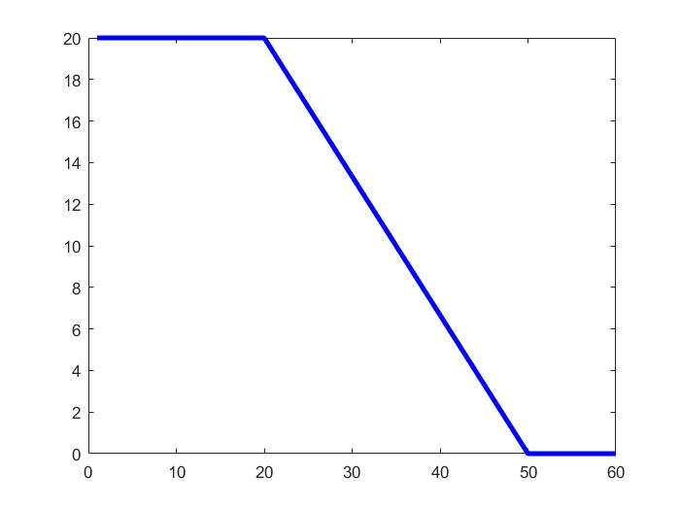
The Healthy Eating Index - 2005
The score for SoFAAS as a percentage of energy is

Slide 33
Global Patterns: HEI-2005
 | Hazard Ratio | p-value
Men, Colorectal | 0.67 | < 0.001
Lung | 0.35 | < 0.001
Women, Colorectal | 0.76 | < 0.001
Lung | 0.42 | < 0.001
Breast | 0.97 | 0.44
HEI-2005 total score in quintiles
Notice this with regard to the WHI results

Slide 34
Global Patterns: HEI-2005
 | Hazard Ratio | p-value
Men
All cause mortality | 0.37 | < 0.0001
Women
All-Cause mortality | 0.32 | < 0.0001

Slide 35
My conclusions
These and other results convinces me that diet matters
It is highly multivariate
Lots of things light up in a multivariate analysis
The components though are fairly highly correlated (if you eat whole grains, you eat total grains)
Substantial evidence that better diets are useful

Slide 36
Measuring Diet
The results I just showed you are based on food frequency questionnaires.
You answer questions about your diet, then are followed
Tough exercise
30

Slide 37
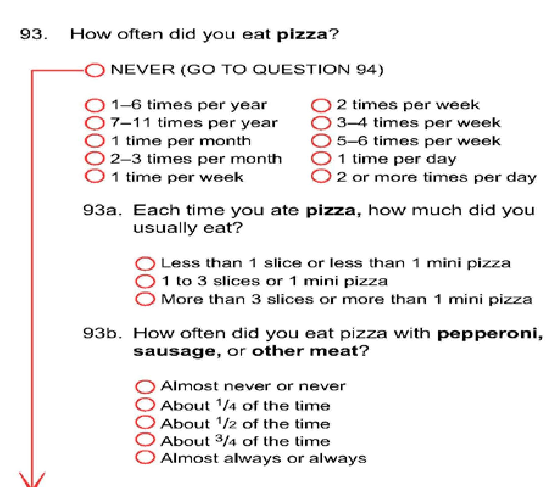
The Pizza Question

Slide 38
Nutritional Surveillance
I have worked with NCI, USDA and Waterloo nutritionists
They said to me that “We are being told that 30% of US children aged 3-8 have an alarmingly bad diet. We do not believe it. Can you investigate?”
Nice challenge. I could not resist it ☺

Slide 39
Measuring Dietary Intake
The National Health and Nutrition Examination Survey (NHANES) is a rolling 2-year wave of interviews, nationally representative of the U.S.
They measure diet by one-two 24-hour recalls (24HR)
Random days selected, etc.

Slide 40
The 24HR Recall
Often done by a trained interviewer over the phone or in person
There are now web-based tools being deployed
The key is that it is a measure of what you ate yesterday
It is not a measure of habitual (long-term) average) intake

Slide 41
The 24HR Recall
The 24HR is a good measure of intake on a single day, but as a measure of usual intake it does not account for day-day variability
The sample mean 24HR value can be used as an estimate of the population mean usual intake
My claim: The sample distribution of 24HR is a terrible, abysmal, ridiculous estimate of the population distribution of usual intake

Slide 42
Context
The data we use are from the NHANES survey of children aged 2-8 in the U.S.
The data set has 2,300 children with a 24hr
There are roughly 700 with two 24hr
This is a real survey, and survey weights are incorporated into the analysis

Slide 43
Context
Our goal is to give realistic estimates of dietary intake distributions and dietary patterns that account for the day-to-day variability
We also want to estimate the real relationship between nutrition and cancer, while accounting for day-to-day variability
Today we focus on the first problem. But we have also done the second

Slide 44
Goal
What is the distribution of long term dietary pattern scores, such as the HEI-2005 or the Mediterranean index?

Slide 45
The Healthy Eating Index - 2005
Now comes the hard part. An example:
In this formula, “Cups” is long-term daily average number of cups consumed.
“Energy” is long-term daily average number of calories consumed
These are called Usual Intakes

Slide 46
Dietary Reality
Assumption: 24HR’s are unbiased measures of usual intake as measured by multiple 24HR

Slide 47
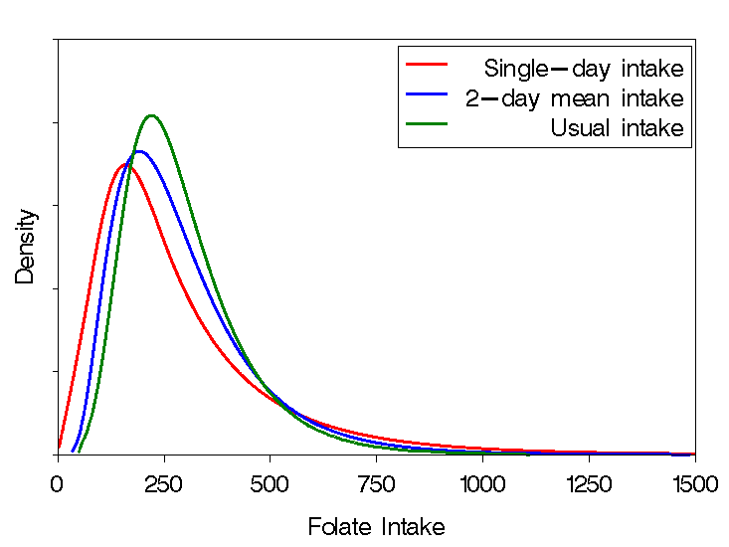
Folate: Right-Skewed Distributions
Note here that a single 24hr is shifted left compared to usual intake, although the means are the same due to some unusually high days of intake
Source: EATS

Slide 48
Transformations
To deal with the skewness, it is typical to transform the data so that day-to-day variation has a nice Gaussian-like distribution.
One analyzes in this transformed scale, and then back-transforms to the original nutrient scale
38

Slide 49
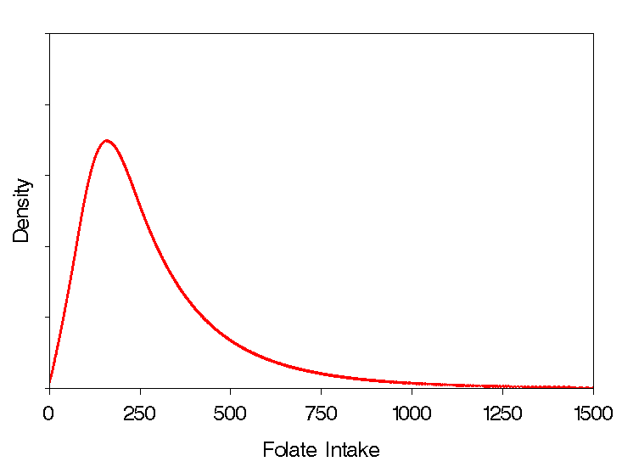
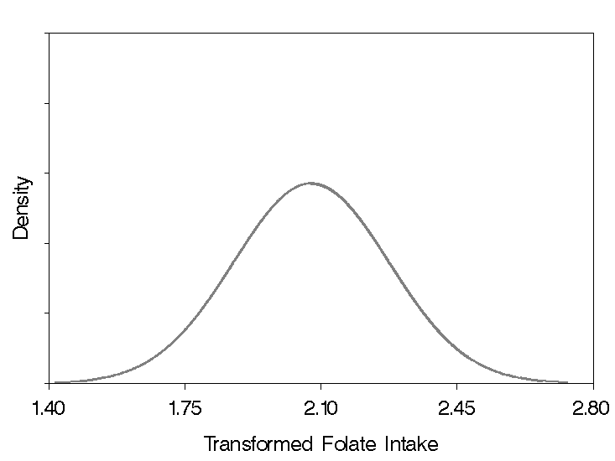
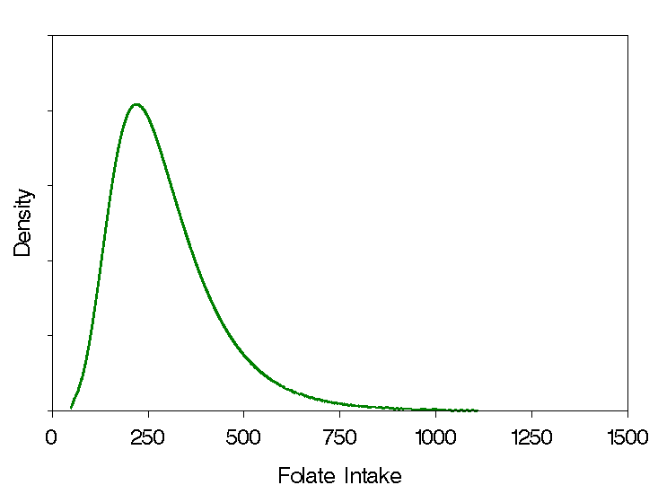
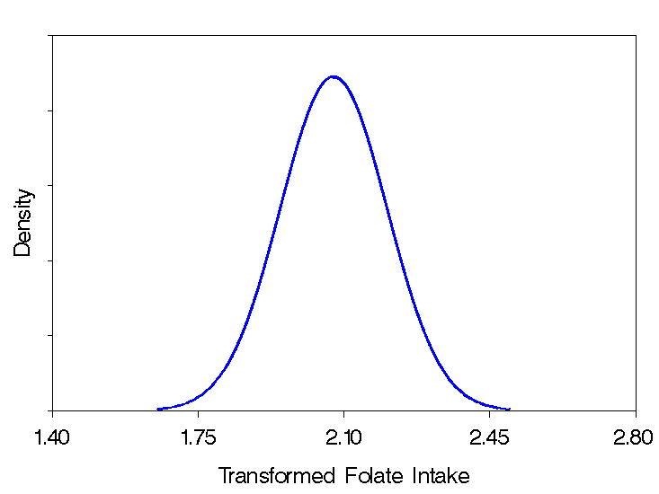
Modeling With Transformations
Original Scale
Transformed Scale
Transform
Backtransform
Source: EATS

Slide 50
Episodically Consumed Foods
The HEI-2005 has 6 components that are episodically consumed. Among children aged 2-8 in the U.S., here are the percentages of reported non-consumption on a 24hr
Total Fruit = 17%
Whole Fruit = 40%
Whole Grains = 42%
Total Veggies = 3%
DOL = 50%
MilK = 12%

Slide 51
Models
We have developed models and programs for one food at a time
Just look up NCI Method

Slide 52
So, What’s the Big Deal?
HEI is complex, because it has 6 episodically consumed foods, 6 daily-consumed foods and nutrients, and energy.

Slide 53
A Multivariate Model
What features do we need to model?
Covariates, such as demographics
That people with the same covariates may differ in their propensity to consume and the amounts they consume
Day-to-day variability

Slide 54
A Multivariate Model
Probability of consumption on a given day
Correlation of the probabilities
Variability of the amounts
Correlation of the amounts

Slide 55
A Multivariate Model
That the observed amounts are skew
Embed all this into a multivariate latent variable model with excess zeros

Slide 56
Computation
There are many technical issues related to fitting the resulting model
Whoopee!

Slide 57
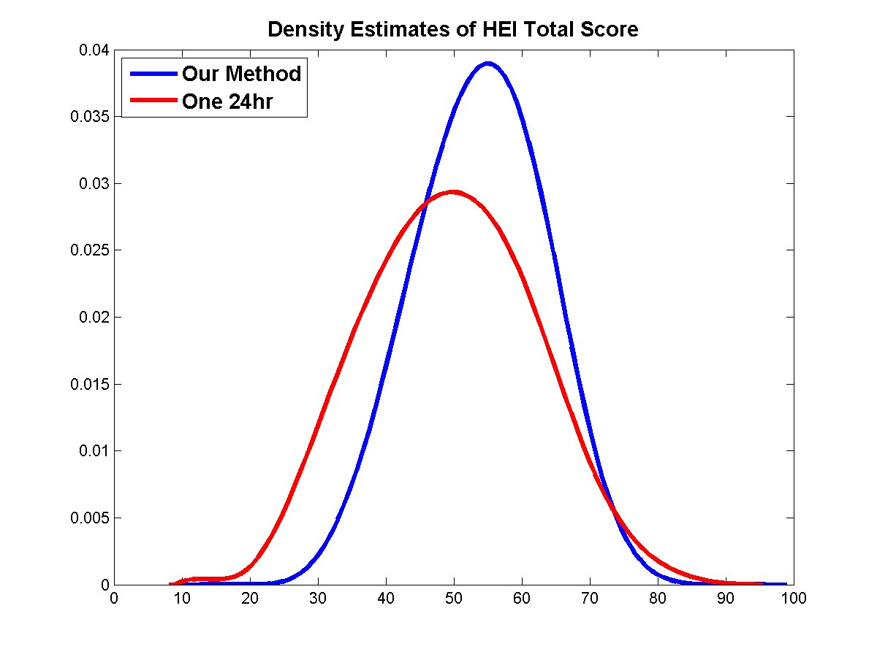
HEI Total Score Percentiles
One 24hr is too pessimistic: thinks 30% have total score < 40 (“alarming”)
We estimate that 8% of children have an HEI-2005 total score < 40
Major policy implications?

Slide 58
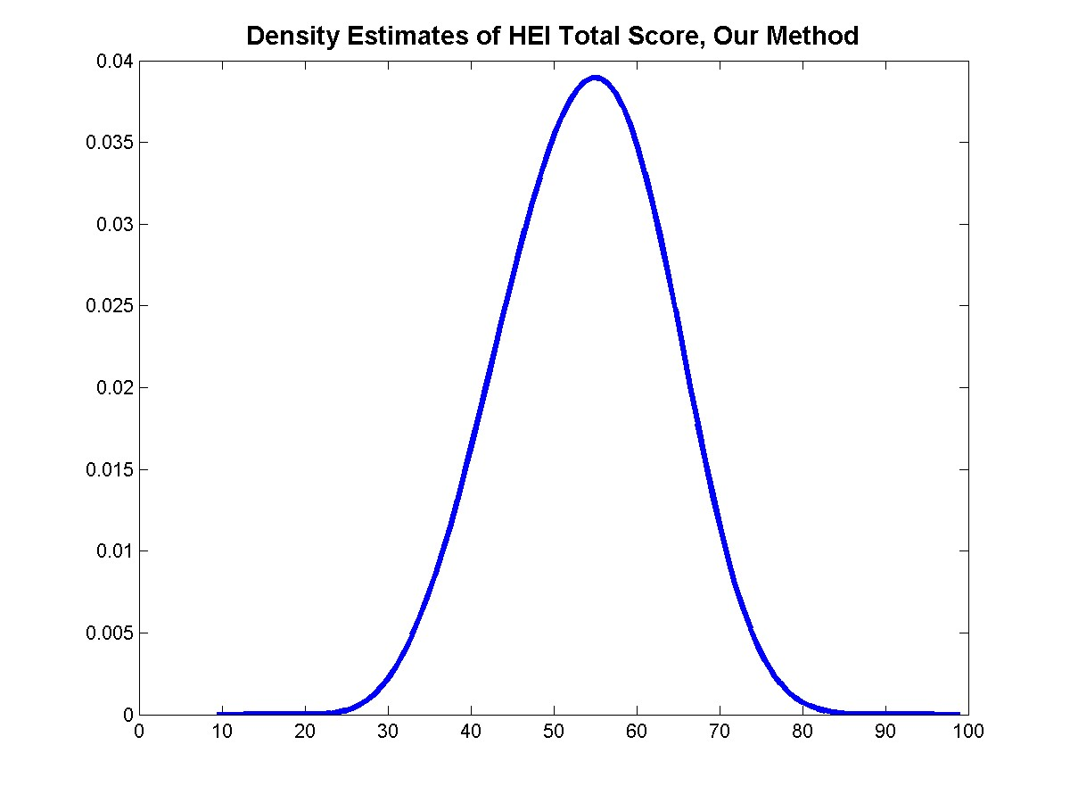
HEI Total Score Density
Essentially no children in the U.S. have a total HEI score of greater than 80.

Slide 59
A Vignette
In about 2011, the White House Task Force on Obesity was about to announce a goal that all children would have a HEI-2005 usual intake total score > 80
The 99th percentile = 79.4. ☺

Slide 60
A Vignette
Confronted with the results, the Task Force changed their goal to have children move to a mean of 80.
However, the mean is 53, so there was a long way to go. ☺
There still is (my opinion)

Slide 61
Summary
Diet and its effects on health is very complex
Expensive to do clinical trials
Many scientific papers focus on magic bullets
I hate kale with a passion: am I doomed?

Slide 62
Thanks for Inviting me!!

